Slide 1

Healthcare Patient Satisfaction Analysis
Analyzing U.S. healthcare patient satisfaction data to identify key drivers of patient experience and operational performance at the state level.
Created by -
Harshit Verma

Slide 2

OVERVIEW
The Challenge
Business Problem
Our Approach
Healthcare organizations face increasing pressure to improve patient satisfaction while managing staffing constraints and operational complexity.
This project analyzes HCAHPS survey results to model satisfaction metrics and construct an Executive Satisfaction Index.
The analysis highlights underperforming states, satisfaction trends, and the impact of communication quality versus operational responsiveness.
Leadership teams need clear, reliable indicators to understand where patient experience is declining and which factors most influence recommendations.

Slide 3
Dataset Overview
1
2
HCAHPS Survey Data
State-Level Metrics
Hospital Consumer Assessment of Healthcare Providers and Systems - the national standard for patient experience measurement.
Top-box satisfaction percentages across states, including nurse communication, doctor communication, staff responsiveness, and hospital recommendation.
3
4
Temporal Analysis
Custom KPIs
Survey participation rates and response data tracked across multiple release periods to identify trends over time.
Executive Satisfaction Index engineered to provide composite view of patient experience and operational performance.

Slide 4




Methodology & Tools
Data Preparation
SQL Analysis
Visualization
Cleaned and standardized survey data, engineered executive KPIs, reshaped into analytical fact table.
Designed state-level analytical schema, queried trends, volatility, and benchmark performance.
Built Power BI dashboard with executive overview and diagnostic deep dive capabilities.

Slide 5


KEY FINDINGS
Critical Insights
Communication Drives Satisfaction
Volatile Responsiveness
Patient-provider communication is the strongest driver of hospital recommendation, outweighing operational delays.
Staff responsiveness shows high volatility, indicating inconsistent operational execution across states.
Declining Trends
Several states demonstrate declining satisfaction, suggesting structural rather than temporary issues.

Slide 6


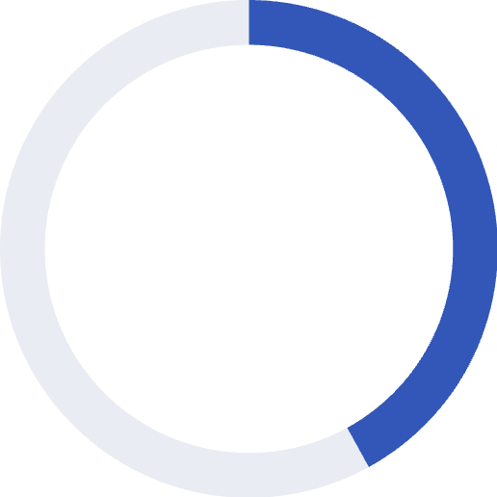

Performance Patterns
1
Top Driver
Communication quality ranks as the #1 factor influencing patient recommendation scores.
42%
Volatility Rate
Staff responsiveness metrics show 42% higher variance compared to communication scores.
Balanced Mediocrity Alert: States with average scores across all metrics still perform poorly overall—composite KPIs reveal hidden performance gaps.

Slide 7

Data Quality Considerations
Survey Response Bias
Temporal Consistency
Low survey response rates introduce potential bias, reducing confidence in reported satisfaction levels across certain states.
Chronological accuracy ensured through proper date sorting and release period validation across all analytical queries.
State-Level Granularity
Analysis conducted at state × release period level, providing sufficient detail for executive decision-making while maintaining statistical reliability.

Slide 8
RECOMMENDATIONS
Strategic Action Plan
01
02
03
Prioritize Communication Training
Redesign Staffing Workflows
Conduct Targeted Audits
Address volatile staff responsiveness by optimizing workflows during peak demand periods.
Launch operational audits in underperforming states showing declining satisfaction trends.
Implement nurse and doctor communication training programs—the strongest driver of patient recommendation.
04
05
Monitor Composite KPIs
Enforce Response Thresholds
Track Executive Satisfaction Index instead of isolated metrics to catch balanced mediocrity.
Establish minimum survey response-rate requirements for decision-making to reduce bias risk.

Slide 9

Dashboard Capabilities
Executive Overview
Diagnostic Deep Dive
Executive Satisfaction Index
Volatility detection by state
Recommendation %, Communication Score, Experience Score
Improvement vs Decline analysis
Metric breakdown table with conditional formatting
Satisfaction trend over time
Bottom-performing states
Drill-through capabilities for root cause analysis
Communication vs Recommendation diagnostic scatter

Slide 10
Project Impact
This project demonstrates how healthcare satisfaction data can be transformed into executive-ready insights using a structured analytics workflow.
Enable Leadership
Track Improvement
Drive Decisions
Composite KPIs and diagnostic visualizations enable teams to identify performance gaps and prioritize interventions.
Structured workflow supports continuous monitoring and measurement of patient experience initiatives over time.
Data-driven recommendations support strategic resource allocation and operational excellence programs.

